Slide 1
Project Meeting
2019/07/03

Slide 2
LoRa Buffer
respberry
Receiver
smart meter
package
smart gateway
Payload 1
package
Payload 2
Payload 3
package
queue
Transform into str
analyze

Slide 3
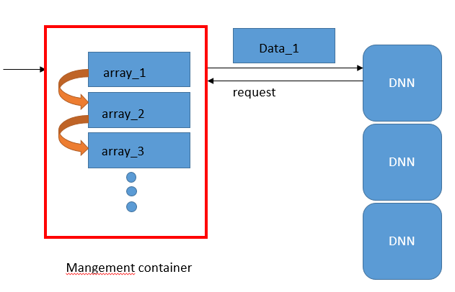
Container Buffer
Transform into str
smart gateway
Management Container

Slide 4
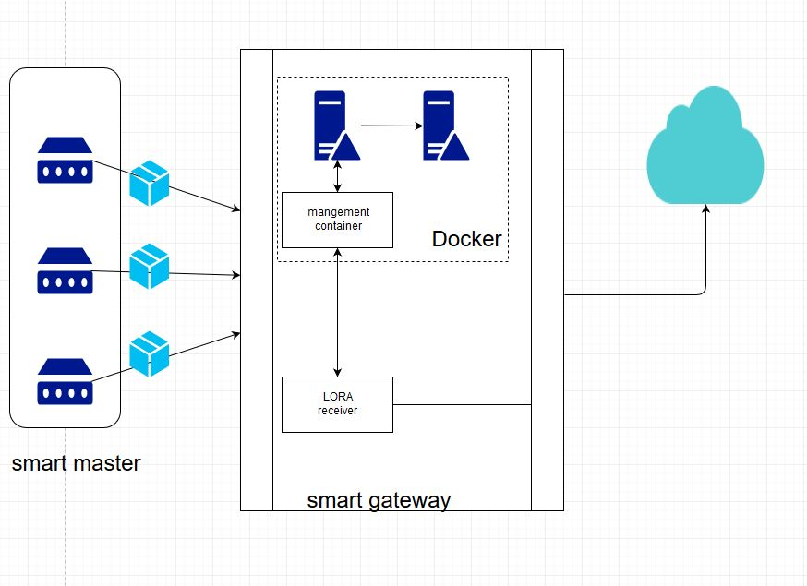
System architecture of Smart Gateway Receiver to DNN container
Receiver
Buffer
Data Transmission
LoRa Receiver.py
Docker
management
container
DNN container
smart gateway ( Raspberry Pi 3 )

Slide 5
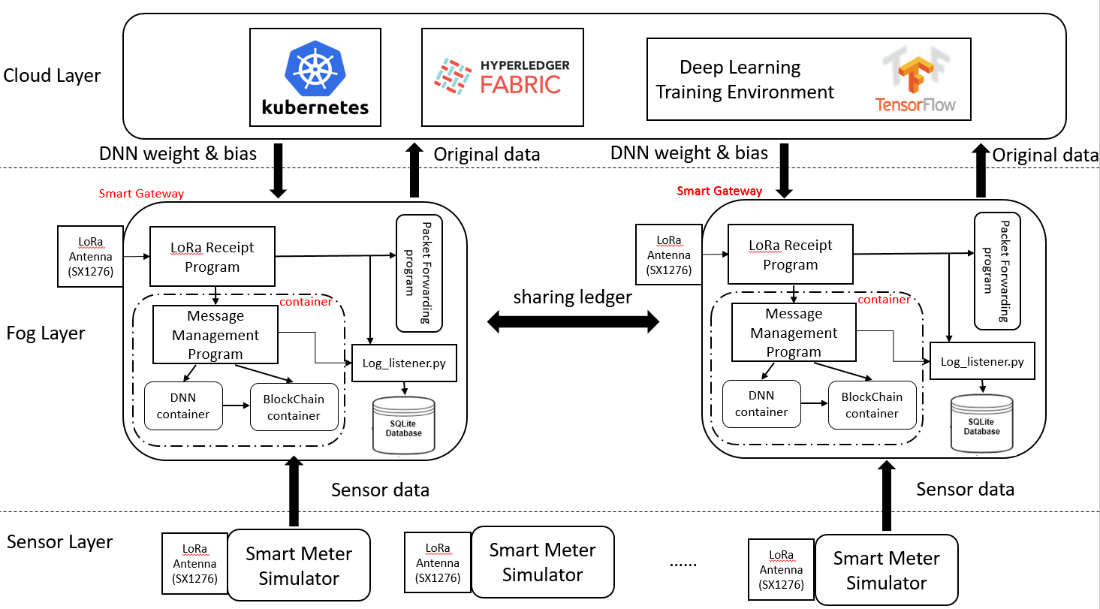
IoT Architecture

Slide 6
整合 IoT and DNN code

